Slide 1
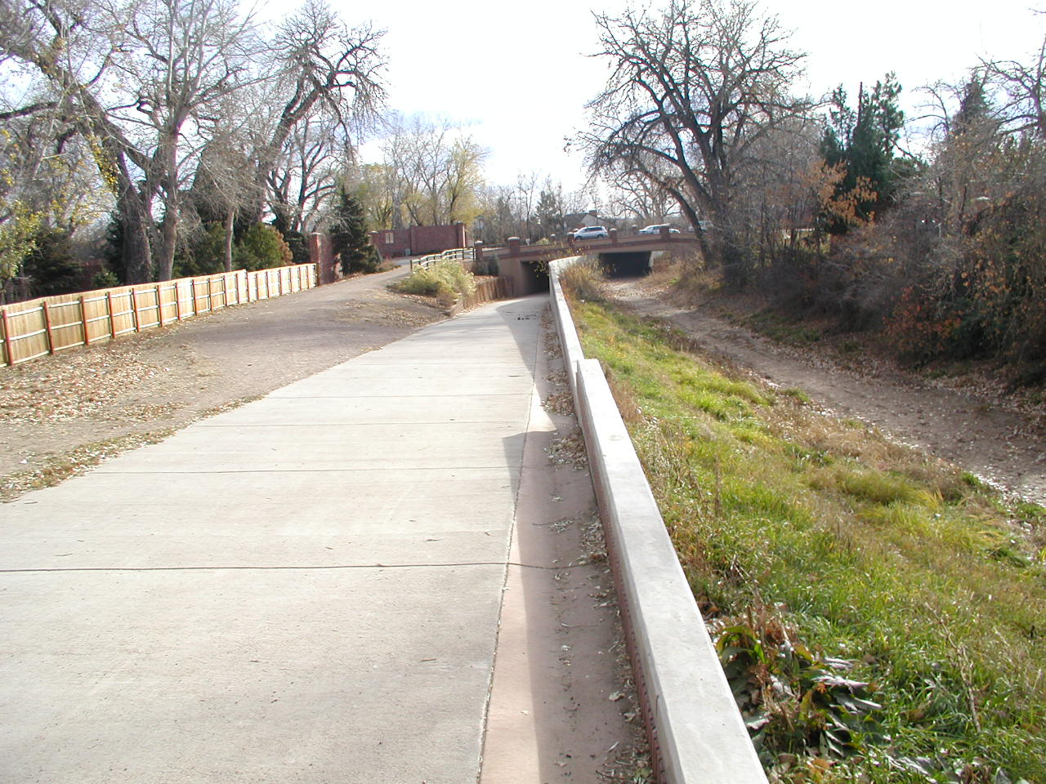
To change background picture, right click on the picture and select “change picture”
HLC FEASIBILITY STUDY Stormwater Treatment and
Runoff Reduction
PROJECT MEETING
March 6, 2014
Presented by
Cory Foreman
Innovation • Collaboration • Inspiration
October 05, 2011
Thinking Together to Inspire

Slide 2
Outline of Project Scope and Schedule
Project Coordination (continuing)
Solicit Stormwater Quality Needs
Obtain Development and Stormwater Improvement Plans
Obtain Information on Stormwater Problems at HLC
Avoid Duplication of Effort
Solicit Input on Others to Participate
Two Formal Presentations
Study Mapping (done)
Use Previously Prepared Mapping
Identify Headgates/Users, Stormwater Inflow and Outflow Locations, Existing and Future Stormwater Crossings
Water Quality Hydrology (done)
Peak Flow Rates and Annual Volumes per Segment (of runoff water needing treatment)
Evaluate Impacts of Upstream Detention (w or w/o WQ)

Slide 3
Outline of Project Scope and Schedule
Canal Water Quality Hydraulic Characteristics (in process)
Estimate Annual Volume of Water Lost to Evapotranspiration, Evaporation, and Seepage
Estimate Volume of Storage Available for Stormwater Use
Conceptual Plan Development (in process)
Plan for Integration into the HLC
Type and configuration of Bioretention WQ Facilities
Strategies to Address Aesthetic and Water Rights Issues
Plan for Stormwater WQ Diversion Into and Out of the HLC
Estimates of Improvement, Operation/Maintenance Costs
Conceptual Plan Evaluation
Quantify Benefits
Identify Constraints and Solutions for Implementation
Evaluate Economic Feasibility

Slide 4
Outline of Project Scope and Schedule
Pilot Project Preliminary Design
Downstream of Fairmont Cemetery
Project Schedule
300 days (10 months)
Month 1 - Study Mapping
Months 2, 3, and 4 – Water Quality Hydrology and Canal Water Quality Hydraulic Characteristics
Months 5, 6, and 7 – Conceptual Plan Development
Months 8, 9, and 10 – Conceptual Plan Evaluation and Pilot Project Preliminary Design
Deliverables
Written Report
Feasibility Drawings Compatible with ArcView
Technical Appendix

Slide 5
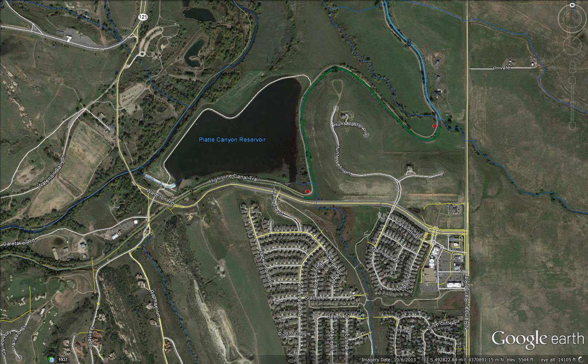
Design Reach Comments
Douglas County
Reach 2 – Little Willow Creek enters directly into the canal at the upstream end of the reach

Slide 6
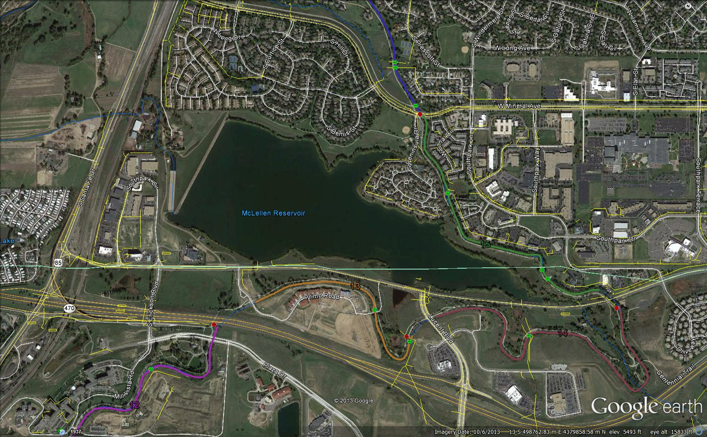
Design Reach Comments
Douglas County
Stormwater discharges to Mclellen Reservoir – Discouraged in the past
Owned/operated by City of Englewood

Slide 7
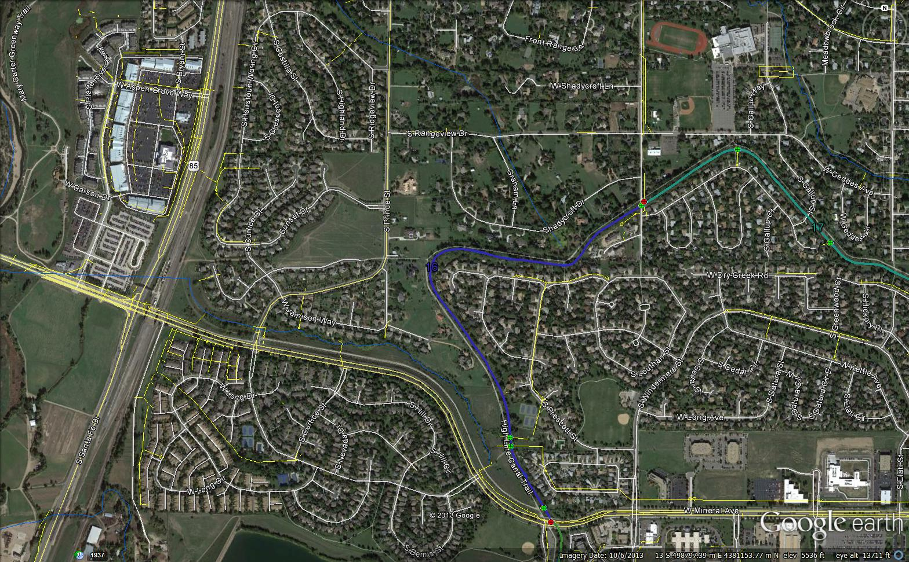
Design Reach Comments
City of Littleton
Stream stabilization project on Jackass Gulch (2014)
Reach 16 - Discharge to roadside ditch, extend to existing storm sewer?

Slide 8
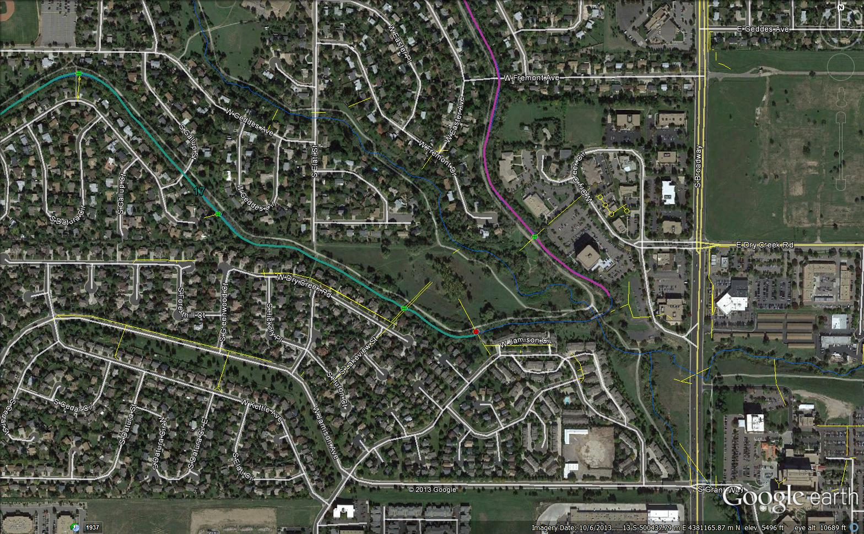
Design Reach Comments
City of Littleton
Discharge to Horseshoe Park, adjacent neighborhood has a strong interest in this natural open space. Public outreach is strongly encouraged during the design process.

Slide 9
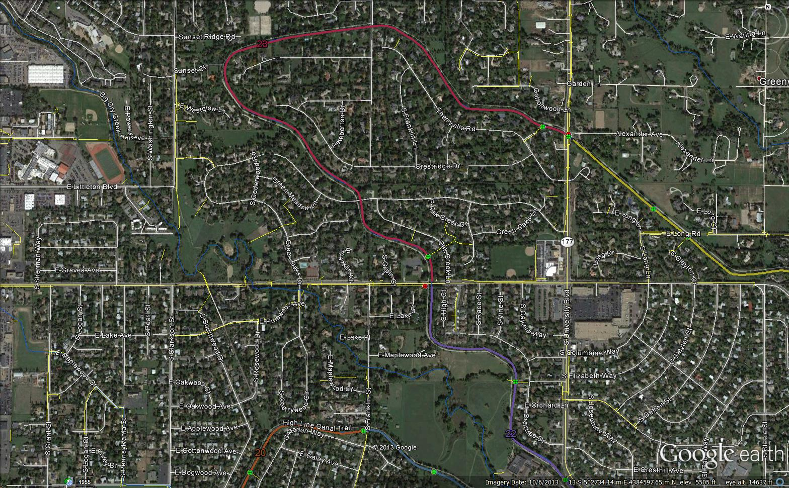
Design Reach Comments
SEMSWA
Discharge point at Orchard Road, storm sewer shown does not exist. (SEMSWA GIS data shows a 24” RCP)
Orchard Road gutter flow could be diverted into canal

Slide 10
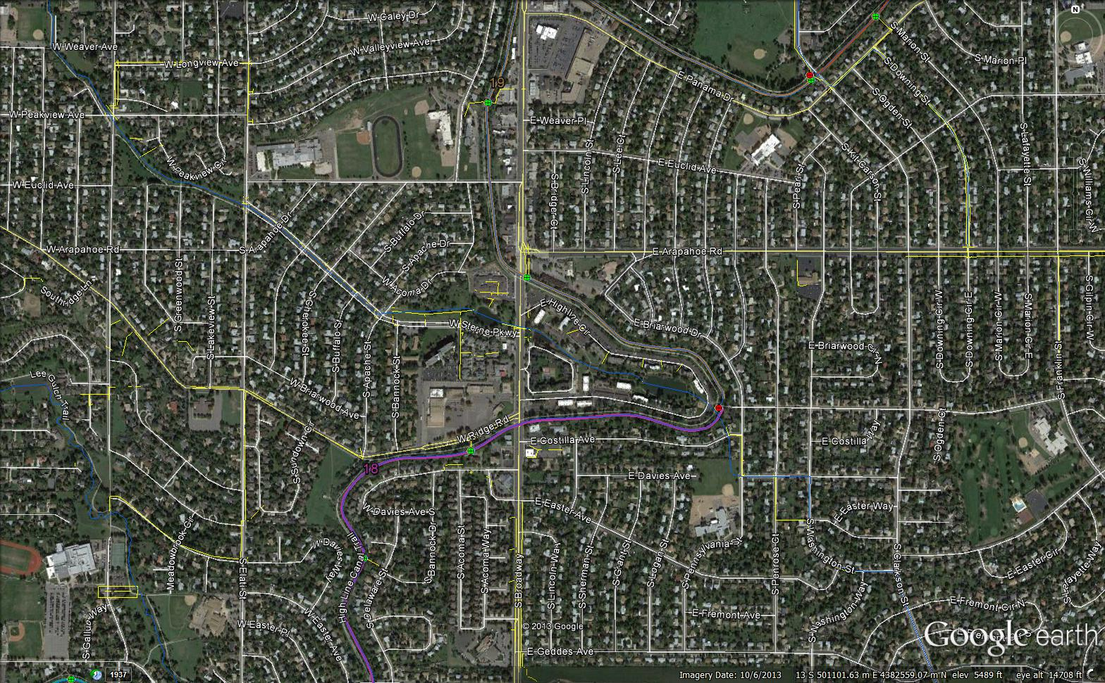
Design Reach Comments
SEMSWA
Reach 18 – 60” RCP inflow location

Slide 11
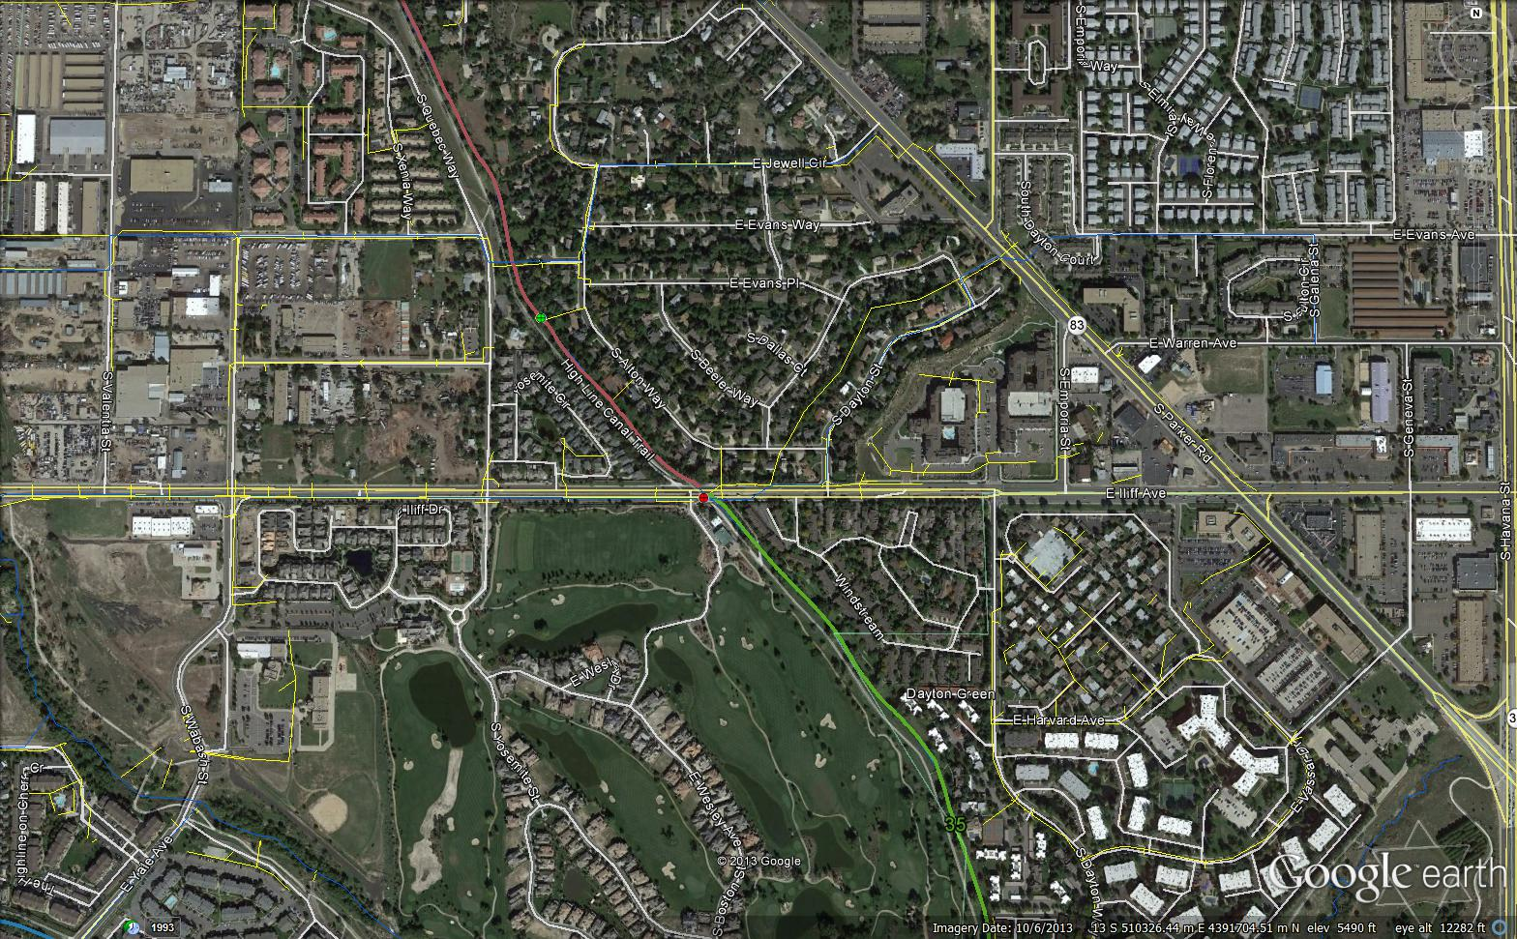
Design Reach Comments
SEMSWA/UDFCD
Add an inflow location at Iliff Ave.
Iliff Ave Corridor Study, canal could provide WQCV for tributary areas east of canal

Slide 12
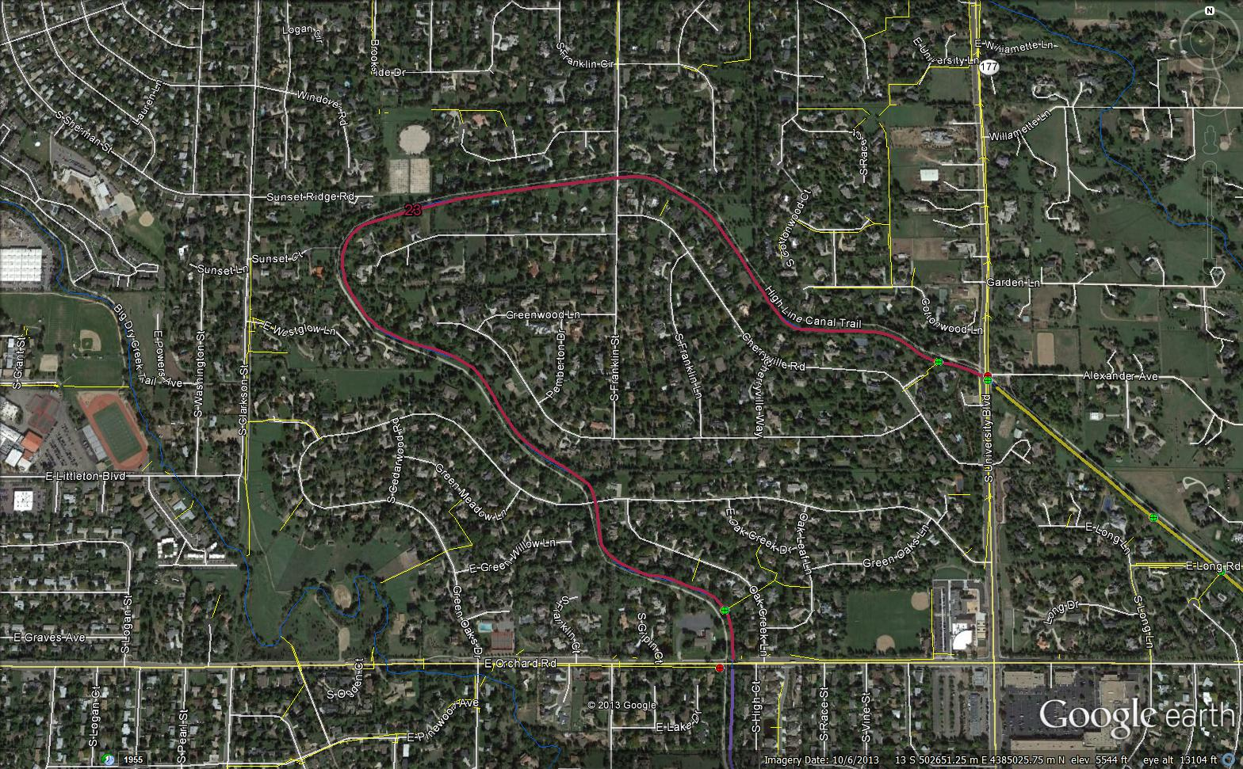
Design Reach Comments
Greenwood Village
Reach 23 exists in a “horseshoe”, naturally drains to canal
Reach discharges to a CDOT system (University Blvd)
Ridge down the center of the basin, flows north and south

Slide 13
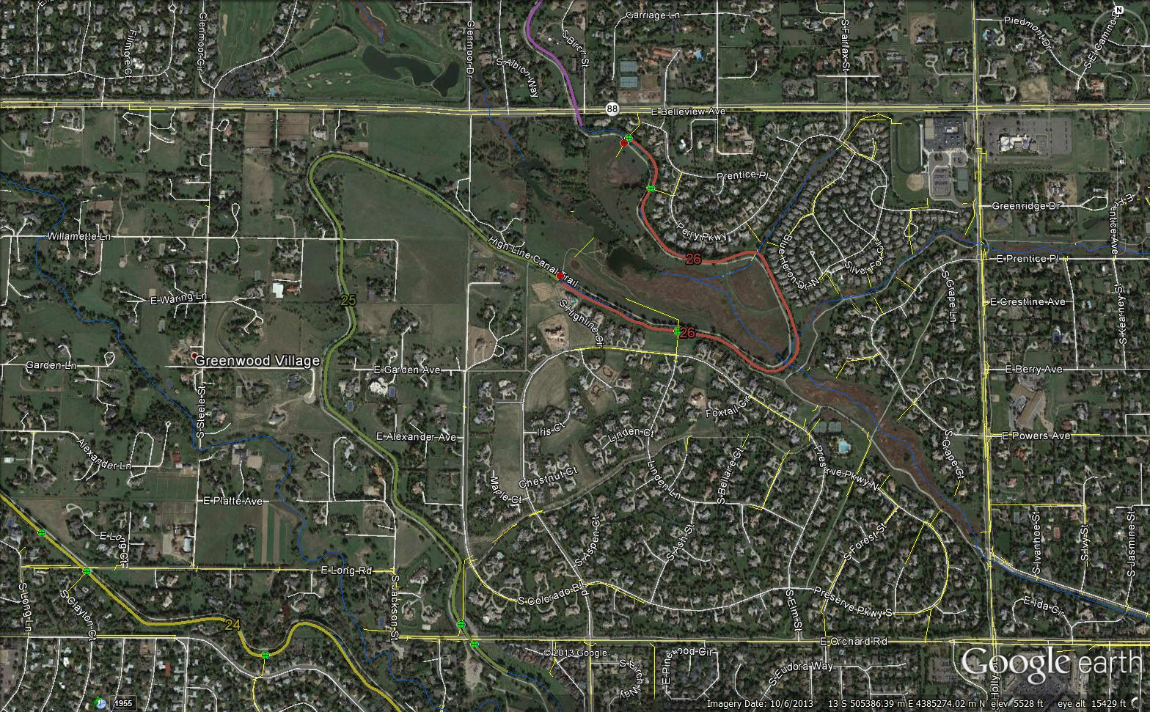
Design Reach Comments
Greenwood Village
Reach 25 – Inflow/discharge locations at existing EDBs
Reach 26 - Greenwood Gulch flows into the canal and discharges further downstream

Slide 14
Pilot Reach Selection
Pilot Reach Selection
Selection Criteria
Downstream of current canal users (Fairmount Cemetery?)
Reach that spans multiple jurisdictions
Detailed mapping already available
1-ft contour mapping preferable
Storm sewer survey or as-built drawings available for entire reach at the inflow / outflow locations
Locations available for new forebays with maintenance accessibility
Minimal existing water quality facilities in the tributary watershed
Diversions into and out of canal hydraulically feasible without large extensions of storm sewers

Slide 15
Pilot Reach Selection
Pilot Reach Selection
Pilot reach would include Denver and Aurora

Slide 16
Water Rights / Water Quality
Water Rights
Excerpts from Sate Engineer’s “Policy” as of May 21, 2011
Administrative Approach for Storm Water Management
The detention areas must release all of the water detained from the site within 72 hours of the end of a precipitation event. Such detention should be designed to release the water from the site as quickly as downstream conditions allow and should minimize consumption from vegetation.
An infiltration area must be designed to infiltrate the water as quickly as possible and shall not result in an exposed water surface beyond 72 hours after the end of a precipitation event. An infiltration area must be designed to minimize consumption from vegetation.
Focus is on whether there is a significant identifiable increase in evapotranspiration from vegetation over the current conditions due to the construction of the water quality facilities
Coordinating with Denver Water on this evaluation
Adjusting design reaches to observe natural watershed boundaries

Slide 17
Water Rights / Water Quality
Water Quality
Using WQ-COSM to determine historical number, frequency, and size of storm events
Use storm event data to compute estimated percent removal of storm water pollutants based upon the volume stored and released over 72 hours.
Use historic data on infiltration to estimate approximate amount of additional pollutant removal in portion of runoff estimated to infiltrate.
Prepare a summary of the expected performance of the individual canal reaches and a cumulative summary of the potential pollutant removal from the entire High Line Canal system.

Slide 18
Benefits / Costs Analysis
Benefits / Costs Analysis
Costs
Construction costs
In-canal facilities (structures / construction and maintenance access)
Diversion and return facilities (structures, pipes, and energy dissipation)
Forebay or equivalent sediment removal facilities / structures
Upstream storm sewer extensions for hydraulic feasibility
Return flow pipelines to appropriate return flow locations
Easements / right-of-way and permitting
Operation and maintenance costs
Facilities upkeep / repair / replacement
Debris and sediment removal and disposal

Slide 19
Benefits / Costs Analysis
Benefits / Costs Analysis
Benefits
Quantified monetary benefits
Tree watering costs provided in the HLC Preservation and Enhancement Planning Study (HLC Working Group). Estimate the extent that these costs may be reduced by the proposed improvements
Reduced need and costs for construction of local water quality facilities as may be needed to meet stormwater permit requirements
Qualified monetary benefits
Estimated removal percentages and amounts of various pollutants
Estimated value of retained recreational use and retained trees
Other benefits?

Slide 20
Coming Up…
Water Rights / Water Quality
Water rights review
Quantification of water quality benefits
Cost Estimates of Facilities
Discussion of Conceptual Design Issues
Draft Report

