Slide 1
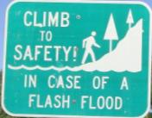
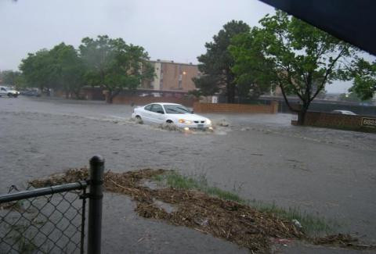
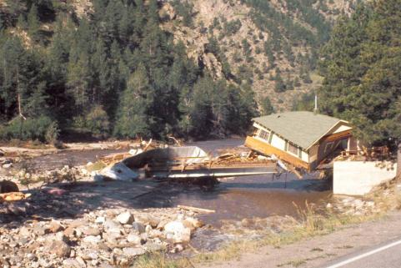

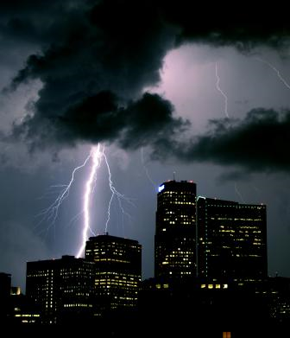
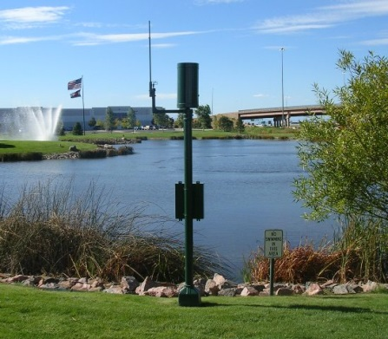
UDFCD’s Flood Warning Program
Websites & Applications
Section 1 | Flash Flood Prediction Program | p.5
Section 2 | The ALERT System | p.24
Section 3 | Radar Options | p.43
Section 4 | Real-Time Hydro Models | p.53
Section 5 | UDFCD Email Subscription Lists | p.55
Instructions | Preparation & Expectations | p.63

Slide 2
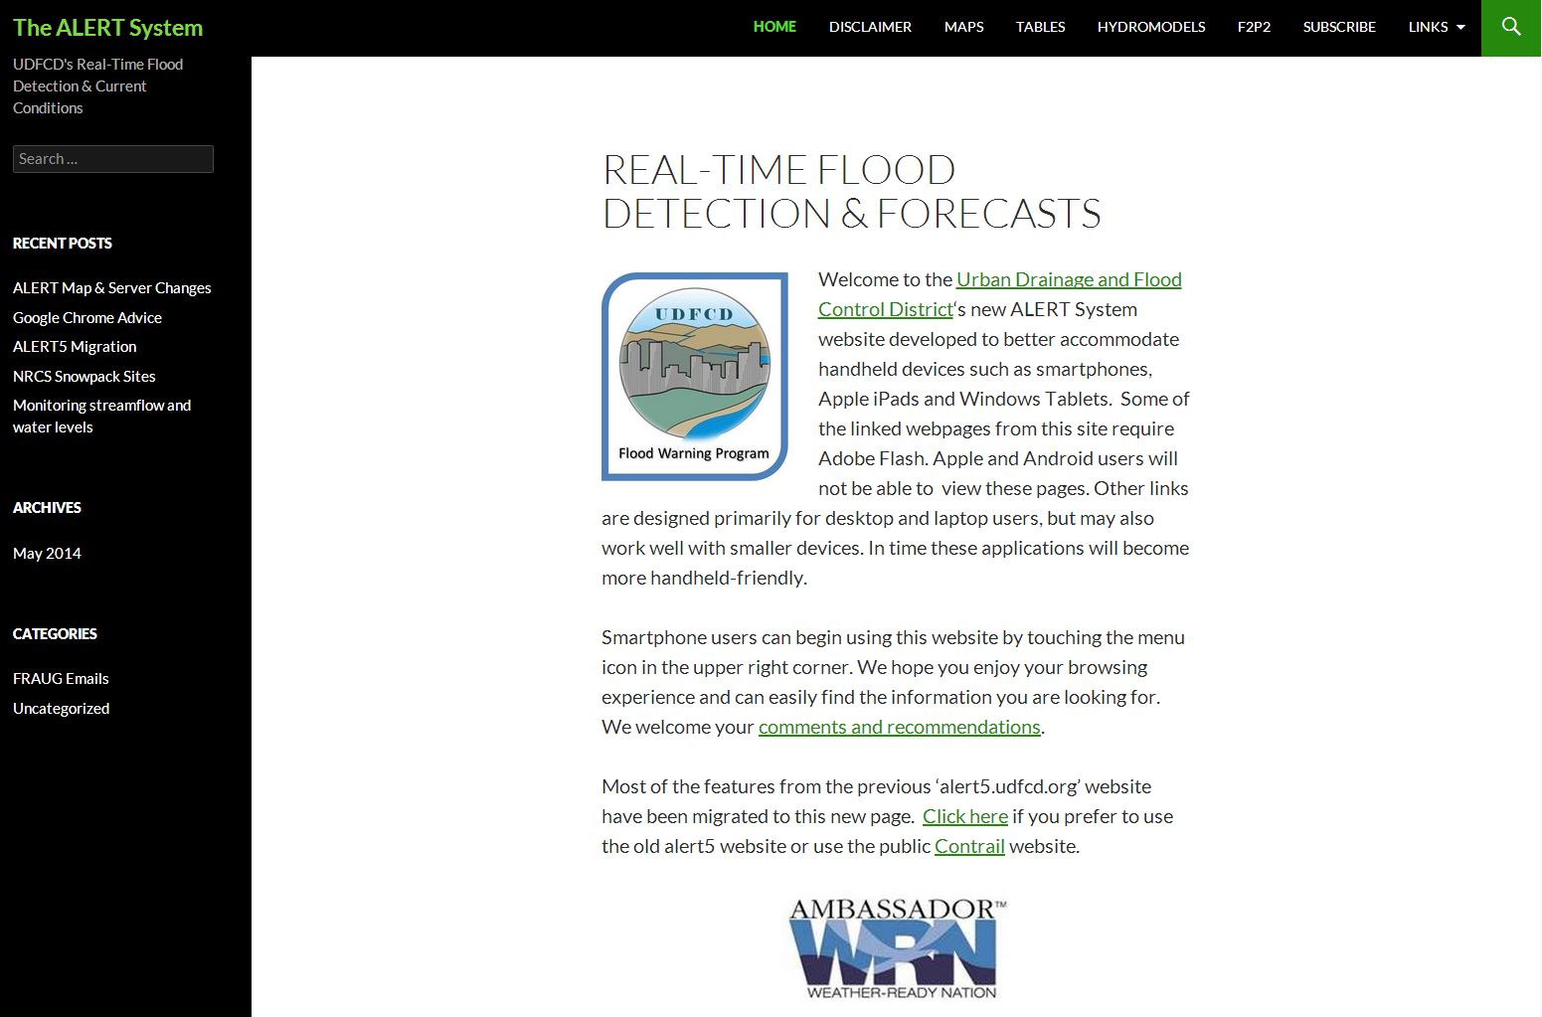
http://alert5.udfcd.org
All key UDFCD-supported websites can be found by starting here.
Old ‘alert5’ website is still available (see p.3)
The ‘alert5’ webpage shown here is the recommended starting page for finding all other webpages and products supported by UDFCD. This webpage is not intended for general public use, so please do not link this URL to any public webpages.
Public website (see p.4)

Slide 3
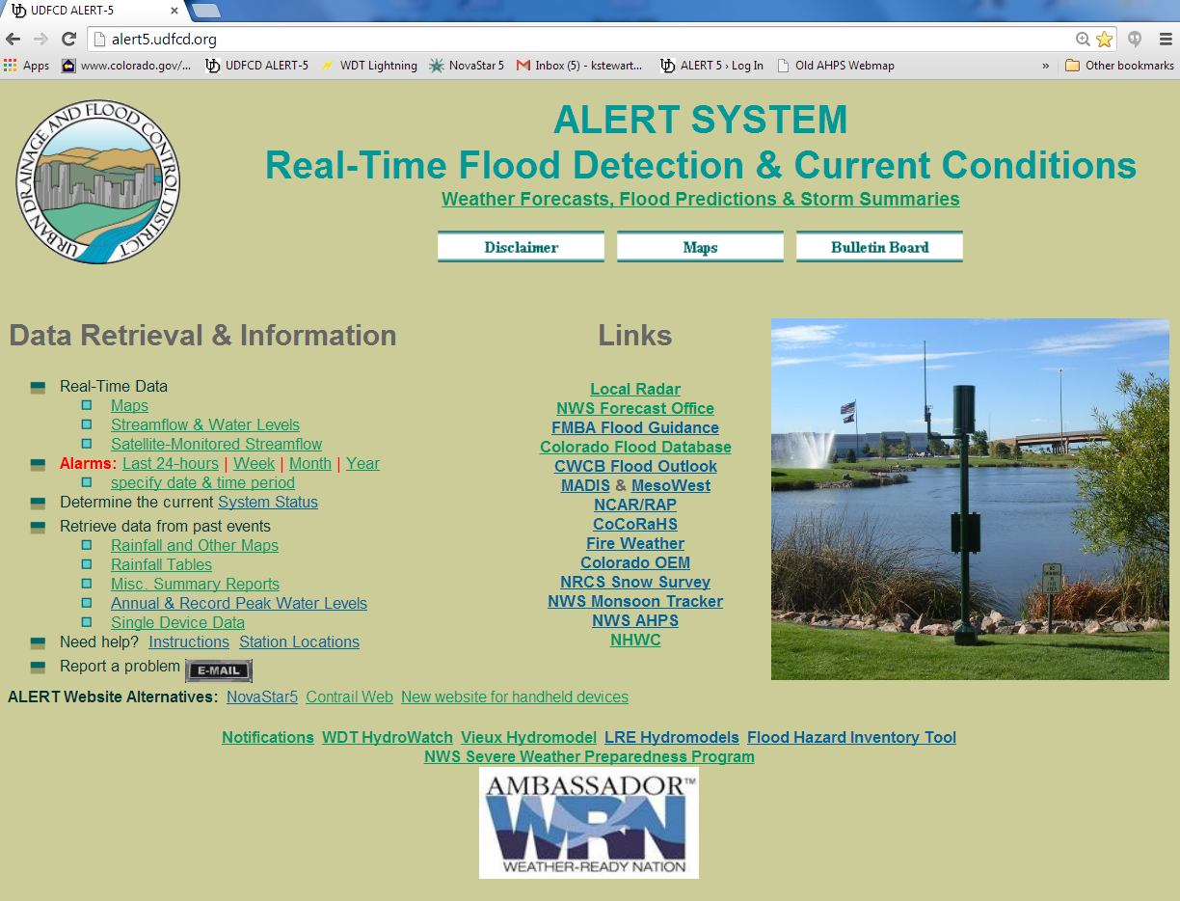
The 2013 ‘alert5’ homepage
All key features and links from this page have been migrated to the new handheld-friendly ‘alert5’ website.

Slide 4
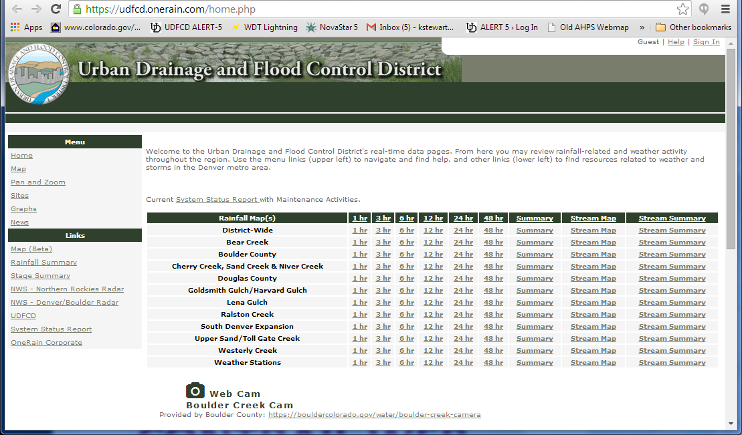
Public Website—Contrail (by OneRain)
This website was developed for public use. You may provide convenient links to this page from your webpages. This site contains many useful features that you may prefer to use operationally and for post-event analysis. Take some time to familiarize yourself with its capabilities.

Slide 5
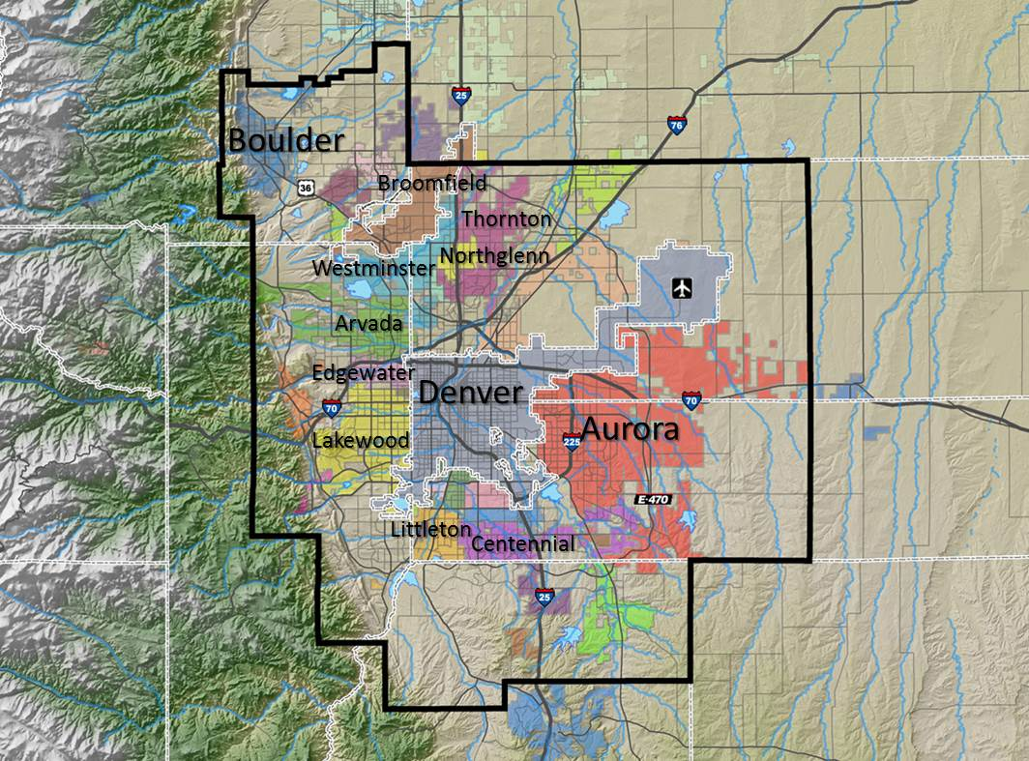
Flash Flood Prediction Program (F2P2)
SECTION 1
Meteorological Products & Services
Serving the greater Denver metropolitan area since 1979
in cooperation with NOAA’s National Weather Service

Slide 6
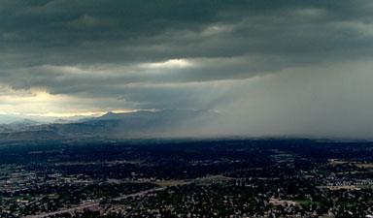
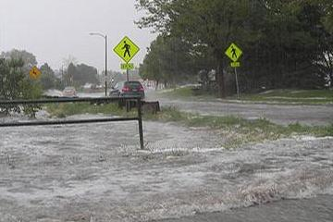
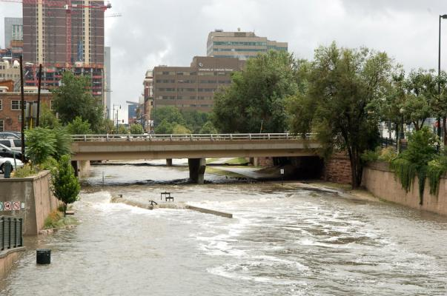
Flood Warning Program
Primary Mission
Provide local governments with early notifications of potential and imminent flood threats (primarily flash flood threats) in time to take appropriate defensive actions…
…to protect lives and property

Slide 7
http://alert5.udfcd.org
F2P2 webpage

Slide 8
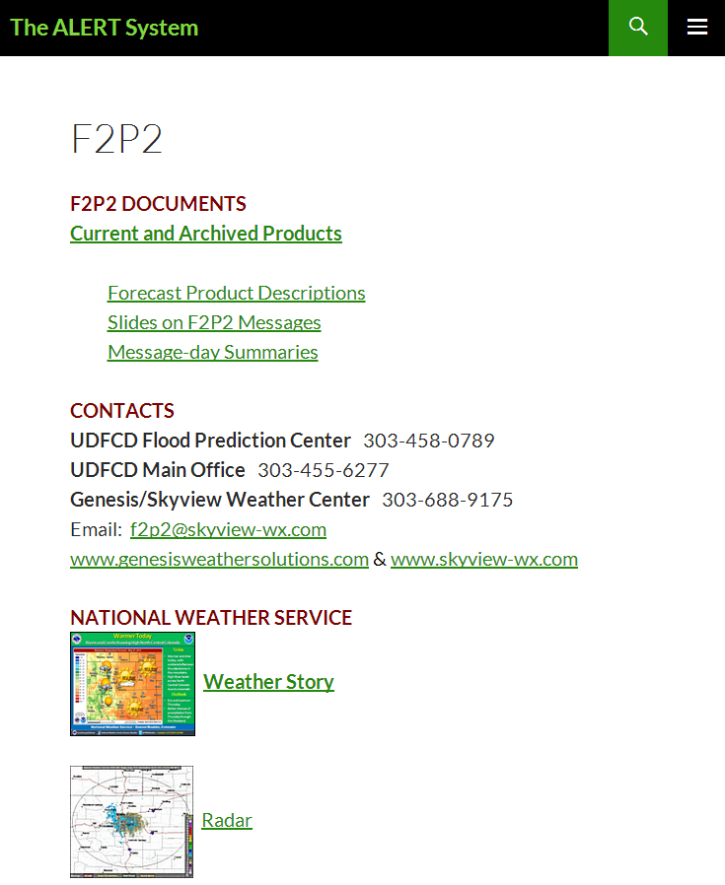
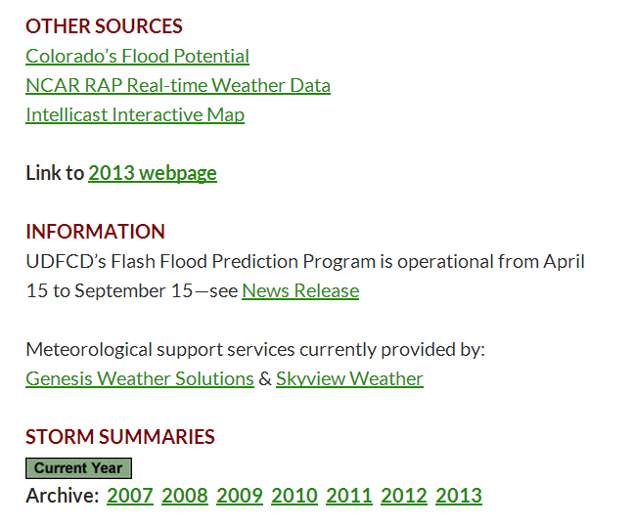
UDFCD employs a private meteorological service (PMS) to provide daily rain forecasts and notify local governments when flood threats develop.
IMPORTANT INFORMATION
Check current forecast

Slide 9
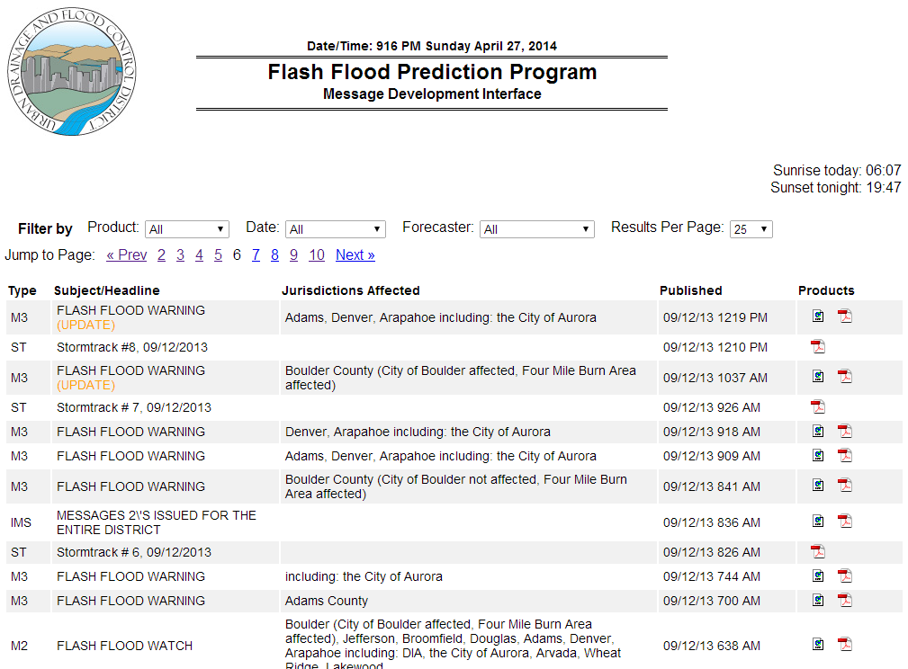
All products are in chronological order with the newest at the top.

Slide 10
Standard F2P2 Messages
Message 1—Street Flooding Potential
Message 1—Low Impact Flooding
Message 2—Flash Flood Watch
Message 3—Flash Flood Warning

Slide 11
Standard F2P2 Messages
Why numbered “MESSAGE” instead of plain language?
The term “MESSAGE” and corresponding numbers (1, 2, 3 & 4) are used to distinguish that the information is from UDFCD rather than the National Weather Service (NWS).
Comparable NWS hydrologic products include:
  Urban and Small Stream Flood Advisories
  Flash Flood Watch
  Flash Flood Warning
Plain language is used with F2P2 MESSAGES to clearly identify the flood threat as being either imminent or potential.
UDFCD local governments are familiar with this program and the practice of using MESSAGE Numbers 1-4.
The numbers & plain language subtitles are used by local authorities to initiate specific operational procedures such as subsequent emergency communications, EOC activations, field resource mobilizations and public warnings.

Slide 12
MESSAGE 1
Street Flooding Potential
subtitle used to inform key people that minor flooding may occur later in the day affecting streets, low-lying areas, normally dry gulches, small streams, and recreational trails along small drainage channels
the most common F2P2 message issued 30 to 40 days per year on the average
Low Impact Flooding
subtitle used when the threat of minor flooding is likely or imminent
flooding will be localized and not wide-spread
not generally considered life-threatening
CAVEAT: Fast moving water even at relatively shallow depths should always be considered dangerous, particularly along rivers, streams and normally dry gulches.
Potential Threat
Imminent Threat

Slide 13
MESSAGE 2 & MESSAGE 3
Flash Flood Watch
subtitle used with MESSAGE 2 to notify key people that the NWS has issued a flash flood watch indicating that a life-threating flash flood may occur later in the day
significant stream flooding and property damage is possible should storms develop
any additional information available will be added
Flash Flood Warning
subtitle used with MESSAGE 3 to notify key people that the NWS has issued a flash flood warning indicating that a life-threating flash flood is imminent or occurring
significant stream flooding and property damage is likely
PMS may issue this MESSAGE on their own if circumstances warrant
Potential Threat
Imminent Threat

Slide 14
MESSAGE 4
All Clear
notification that the flood threat has ended early
issued after consultation with NWS and other entities involved with direct PMS communications
PMS will not issue this when a current MESSAGE is allowed to expire

Slide 15
F2P2 products

Slide 16
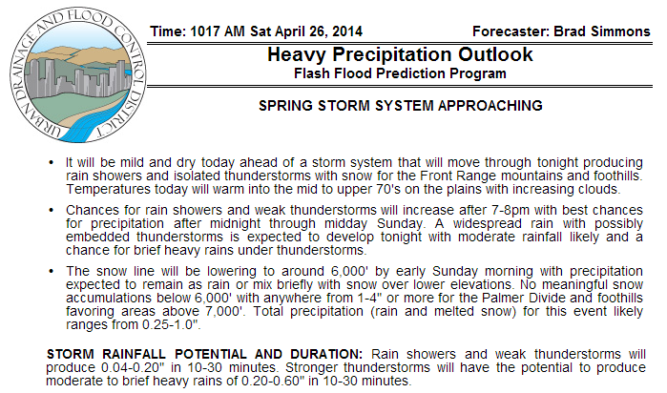
Daily Outlooks & Message Status
HPO by 11 AM daily

Slide 17
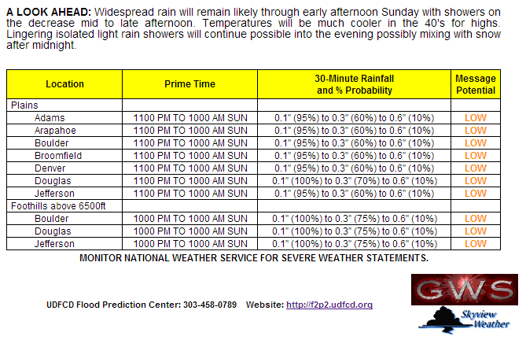
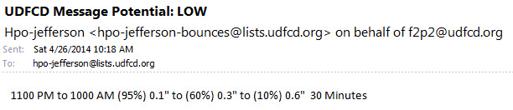
HPO continued…
Lower part of previous slide
A short text jurisdiction-specific version of the HPO is available via UDFCD’s email subscription service described later in this document.

Slide 18
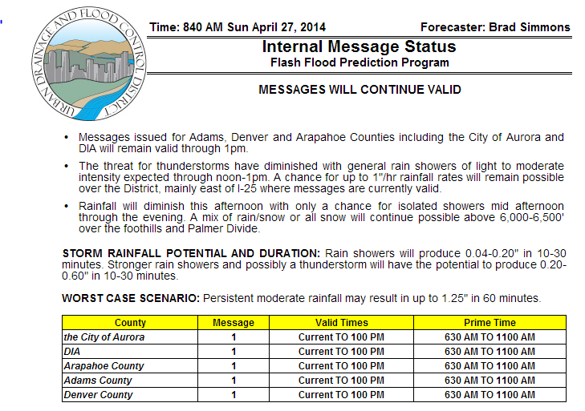
Daily Outlooks & Message Status
IMS format similar to HPO

Slide 19
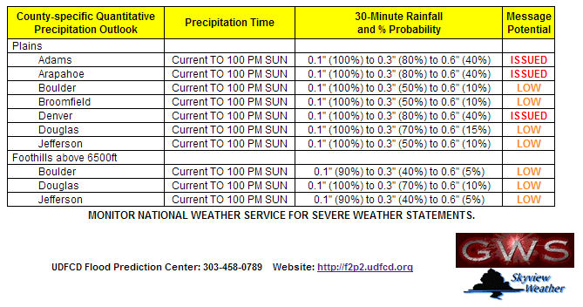
IMS continued…
Lower part of previous slide

Slide 20
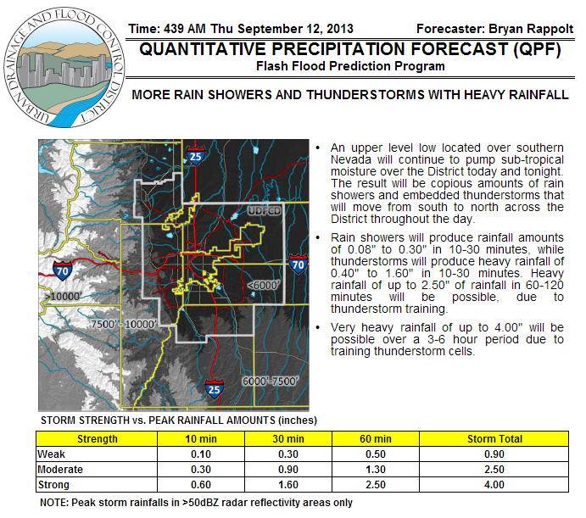
A more detailed QPF
issued when >1.5” is possible in 1hr or less
NOTE: All HPO/IMS products also contain QPF. This product is intended to provide more basin-specific information and characterize a broader range of potential storms.

Slide 21
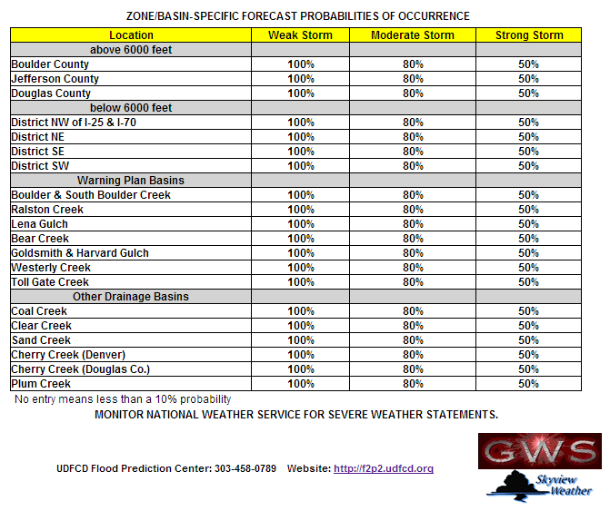
QPF continued…
Lower part of previous slide

Slide 22
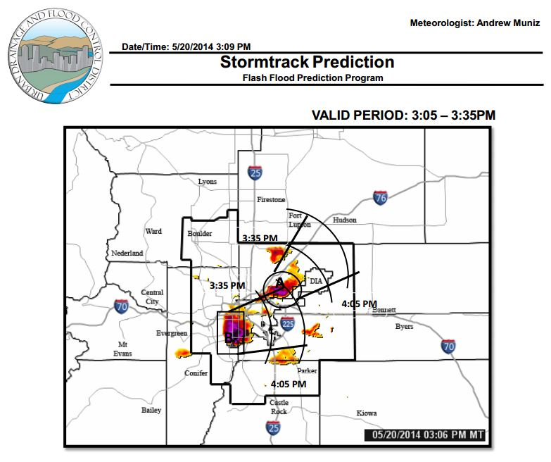
Storm Track
This product shows a radar image and the predicted path and timing of the storm(s). The time stamp at the bottom reflects the radar image snapshot time.

Slide 23
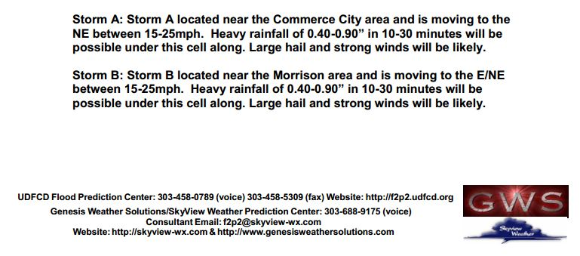
Storm Track continued…
Lower part of previous slide

Slide 24
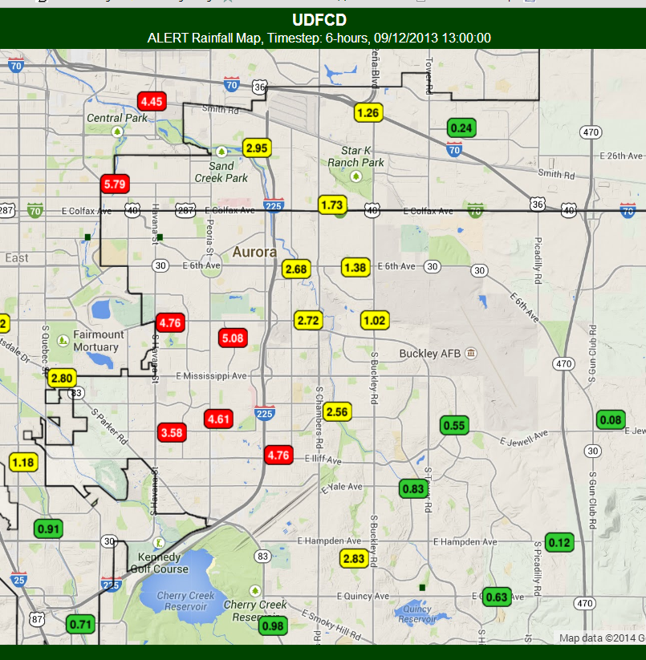
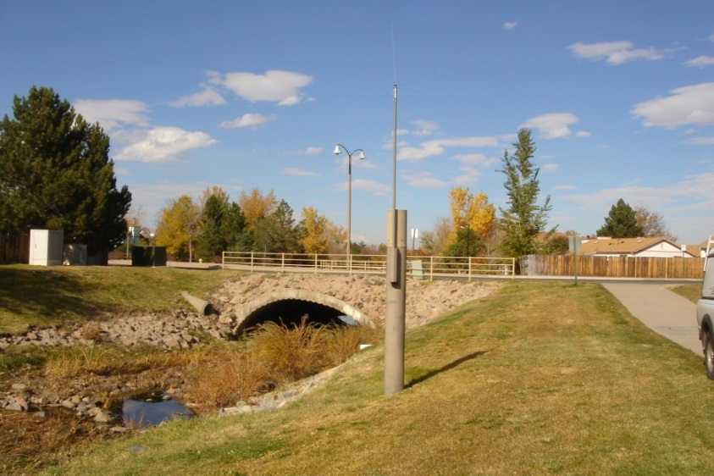
The ALERT System
SECTION 2
Automated Flood Detection Network

Slide 25
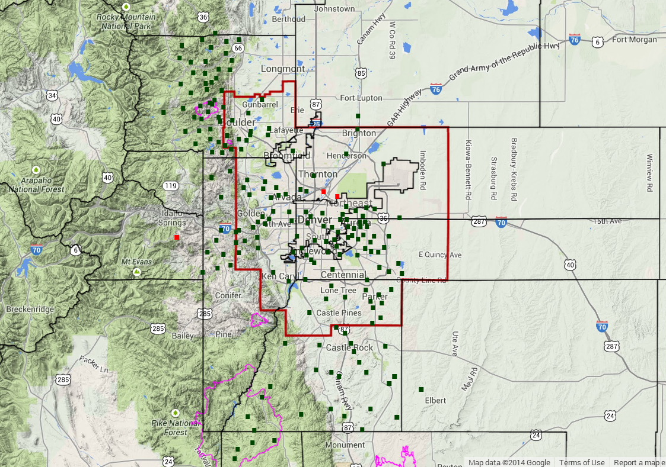
UDFCD ALERT System
2014
195 Rain Gages
99 Streamgages
26 Weather Stations

Slide 26
http://alert5.udfcd.org
Maps are most popular
Click on logo for shortcut to GMap website.

Slide 27
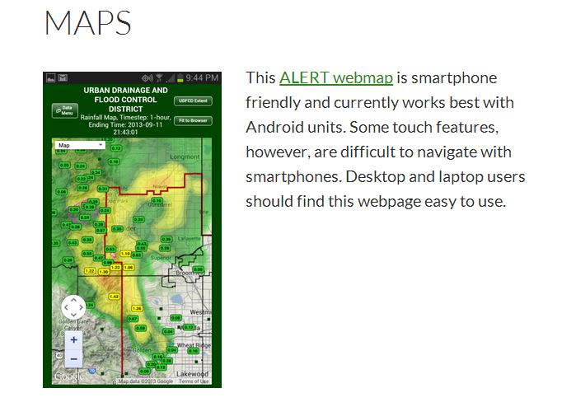
Click on map to launch webpage
This webmap will search for new data every minute and update automatically. The default settings show the last 1-hour of rainfall, the current radar loop and NWS warning boxes. You can change these settings from the [Data Menu].

Slide 28
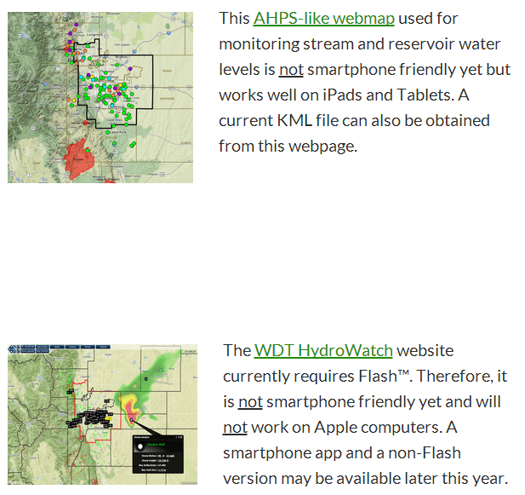
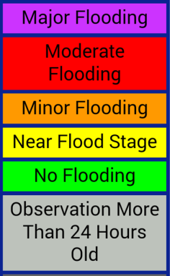
Lower portion of the MAPS webpage
Colored dots on this map represent AHPS thresholds similar to the NWS Rivers & Lakes webpage. See the section on Monitoring Streamflow for more information about this webpage.
Below is a custom radar website developed for UDFCD. See the section on Radar Options for more information about this website.

Slide 29
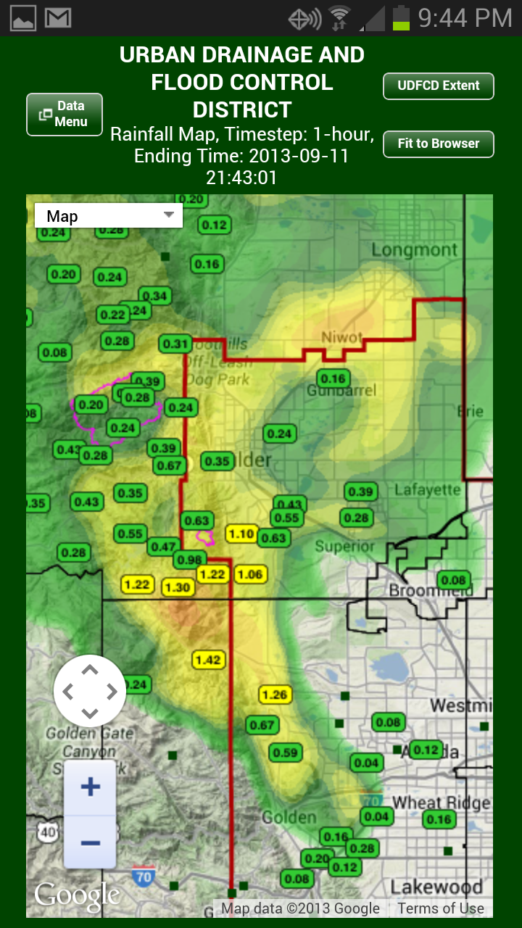
Monitoring Rainfall
SECTION 2.1

Slide 30
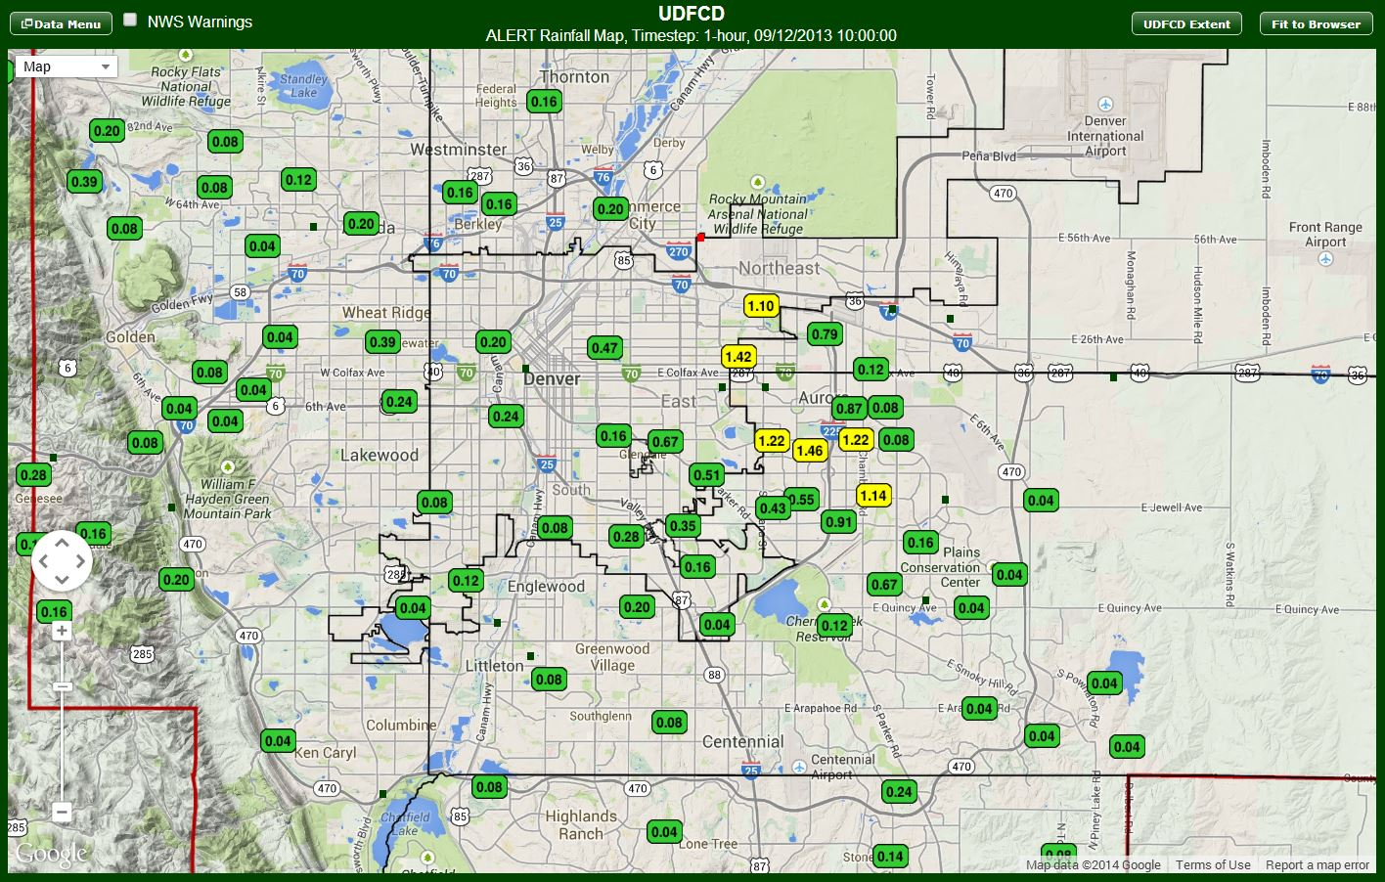
1-hr rainfall totals at 10AM, September 12, 2013
Typical ALERT map display. Colors are used to draw attention to the larger measurements. When amounts exceed 3”, the values display white on red. Clicking on a station will provide more detailed information about the storm.

Slide 31
1-hr rainfall totals at 10AM, September 12, 2013
Click here for Expo Park

Slide 32
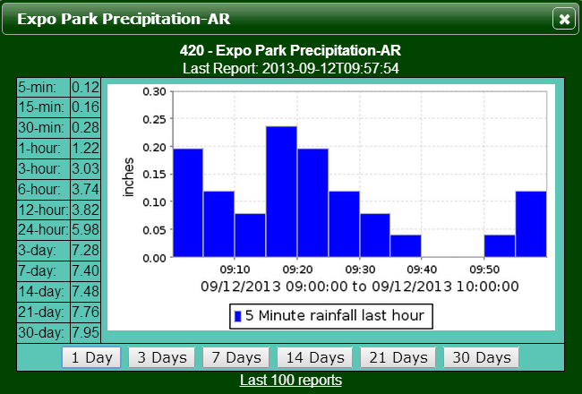
1-hr rainfall totals at 10AM, September 12, 2013
Review precipitation totals and use this info to determine if a response is required.
1”+ in 30 minutes
2”+ in 1 hour
Click here for more rainfall data from Expo Park.

Slide 33
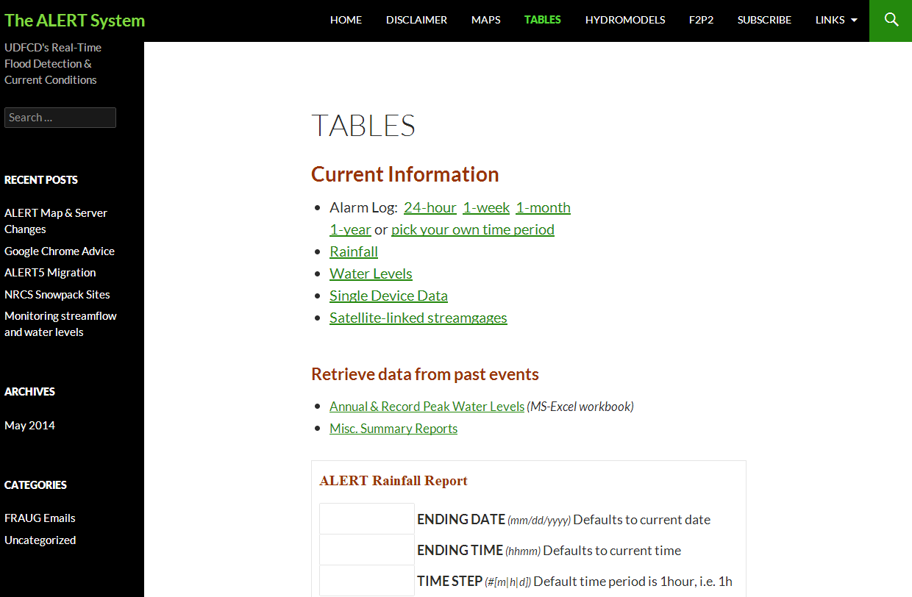
Tables are available from the ‘alert5’ menu shown here and from the ‘gmap’ site.

Slide 34
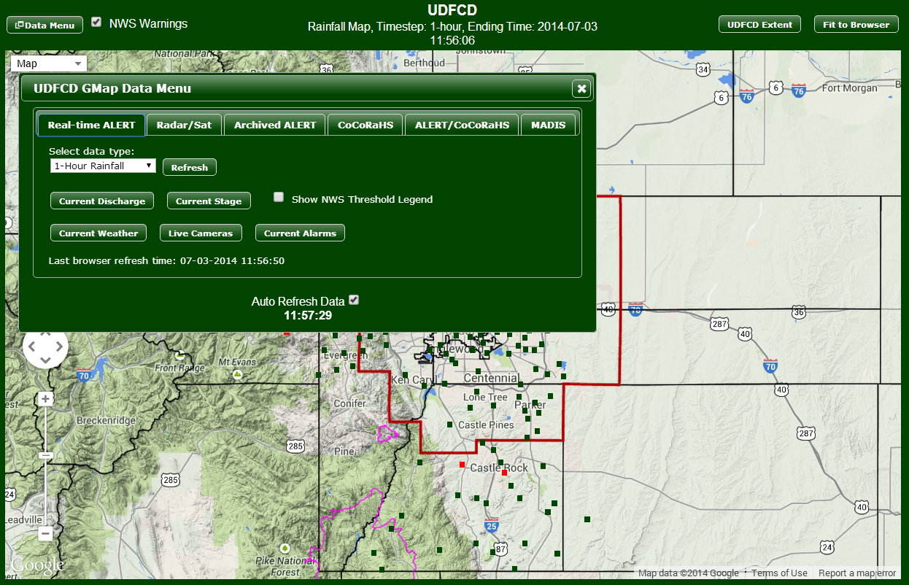
Rainfall & Water Level Alarms
Go here first to access the GMap data menu
Then here for current alarm info

Slide 35
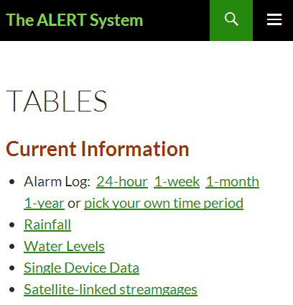
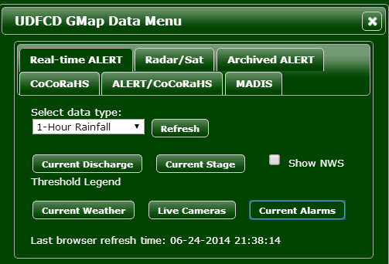
Rainfall & Water Level Alarms
The alarm log table can be accessed from both the ‘alert5’ Tables menu and the GMap Data Menu.

Slide 36
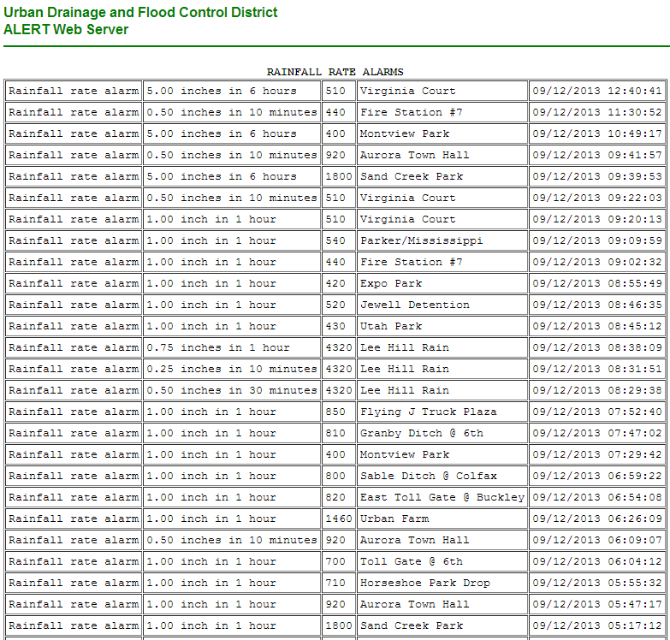
Alarm Log Table
Use the browser refresh button to update the alarm table during a rainstorm.
The RAINFALL RATE ALARMS are followed by stream upper limit alarms and then stream rising rate alarms (see next page)

Slide 37
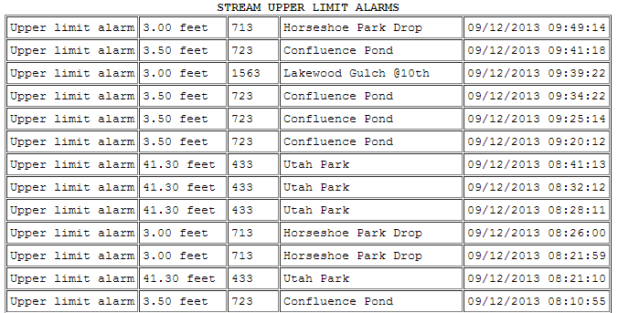
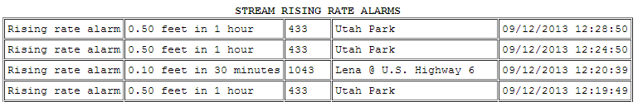
Alarm Log Table (continued)

Slide 38
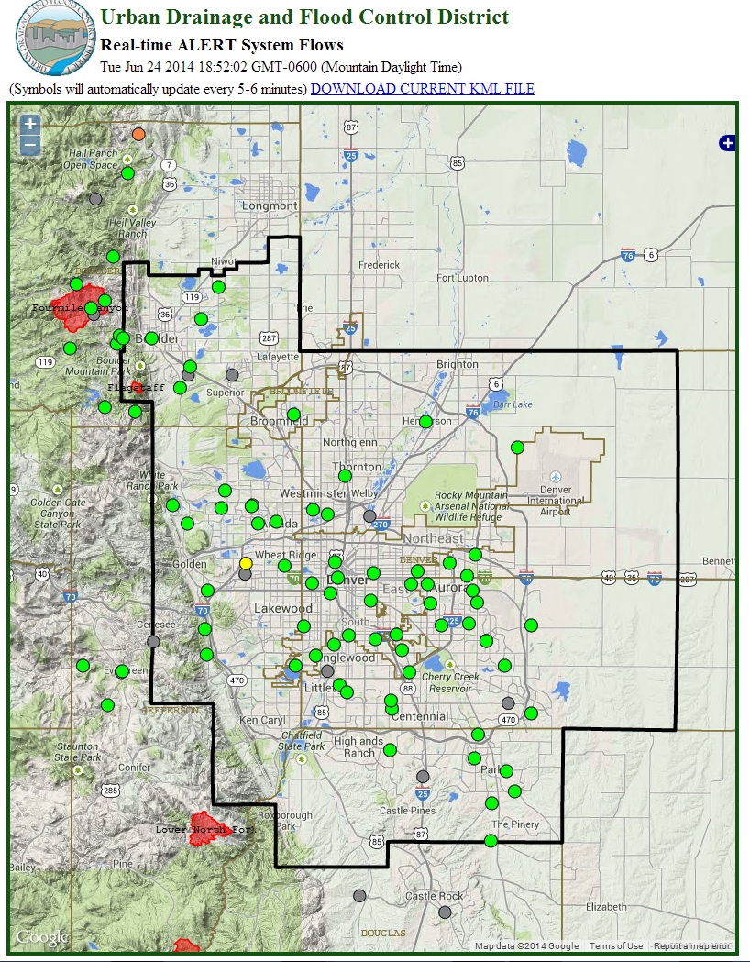
Monitoring Water Levels
& Streamflow
SECTION 2.2

Slide 39
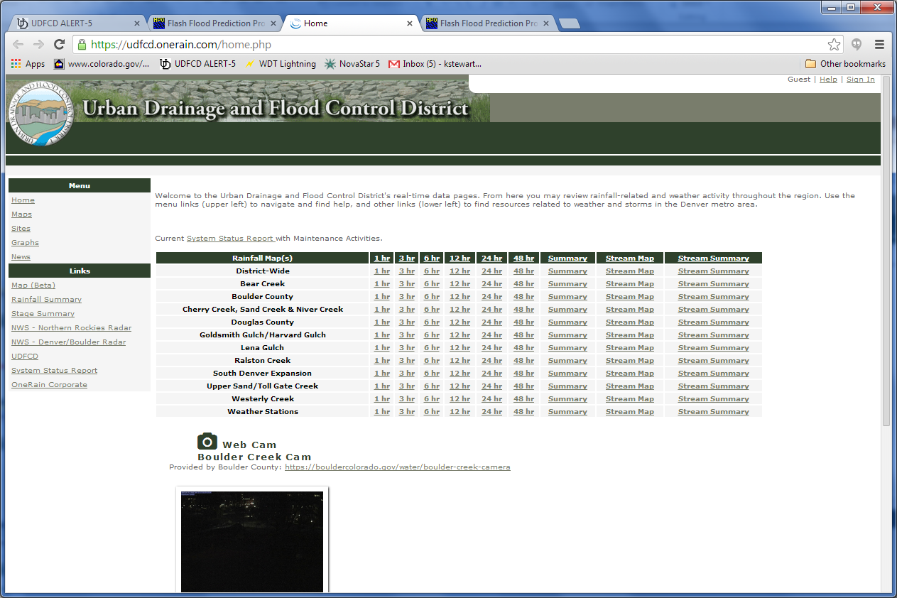
Contrail by OneRain—the pubic website option
Review info for Upper Sand/Tollgate Creek and Westerly Creek. The two major creek systems in Aurora.

Slide 40
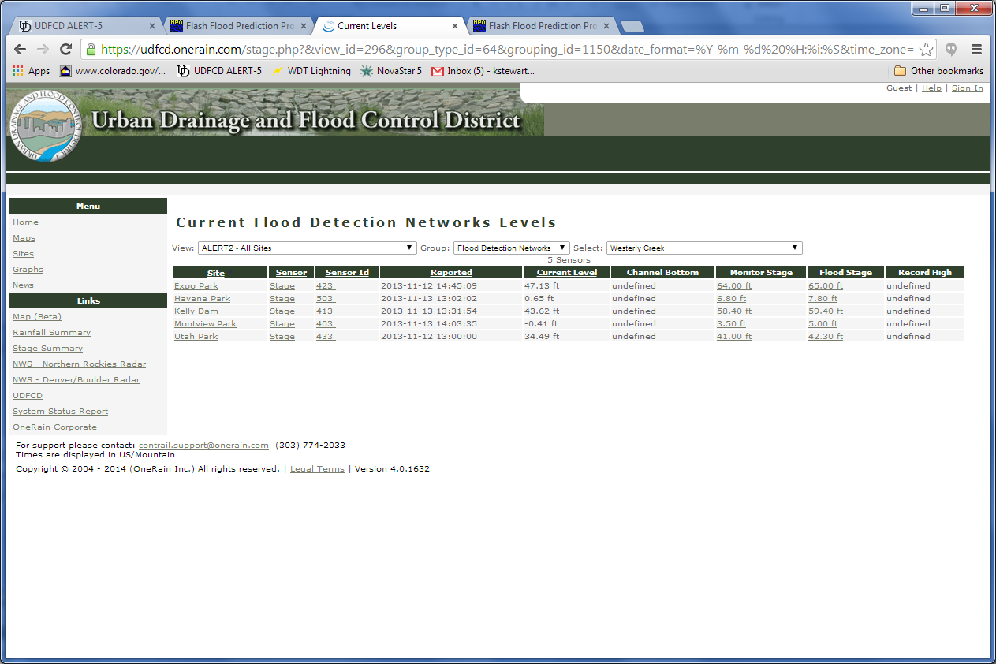
Contrail
Good way to monitor creek flows at multiple locations: compare current level to the flood stage

Slide 41
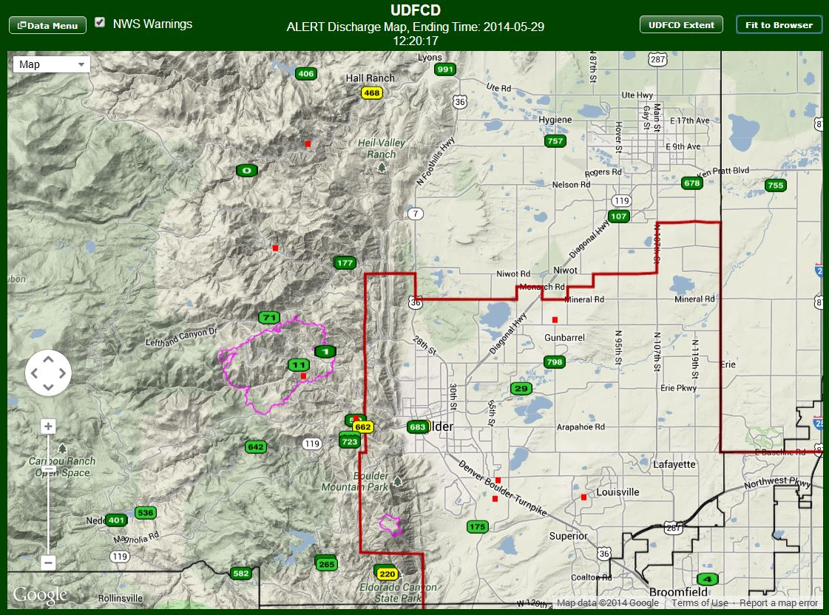
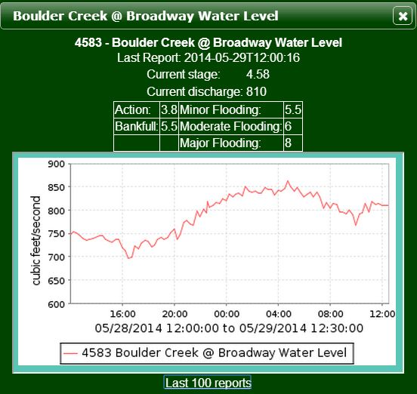
The ALERT map is another easy way to view current water levels and flow rates. Use the Data Menu (top-left) and select either [Current Discharge] or [Current Stage]. You can then view a time series graph by clicking on a station. USGS and Colorado DWR station data are also displayed. Convenient links to other data sources and tables are provided in the graph box. Colors are used to reflect AHPS thresholds used by the NWS. The next slide contains more information about AHPS.

Slide 42
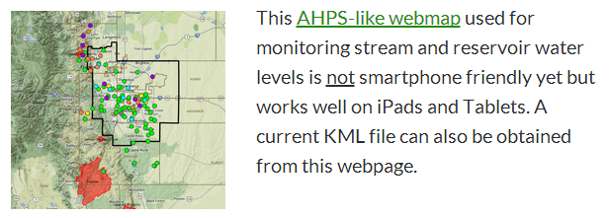
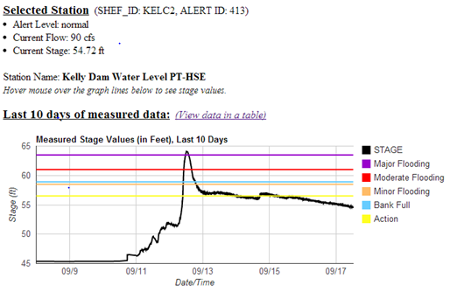

From the alert5 website
Another option for monitoring water levels via the MAPS menu. Colored dots indicate current threat levels. Selecting a site will generate a stage hydrograph and other pertinent information.

Slide 43
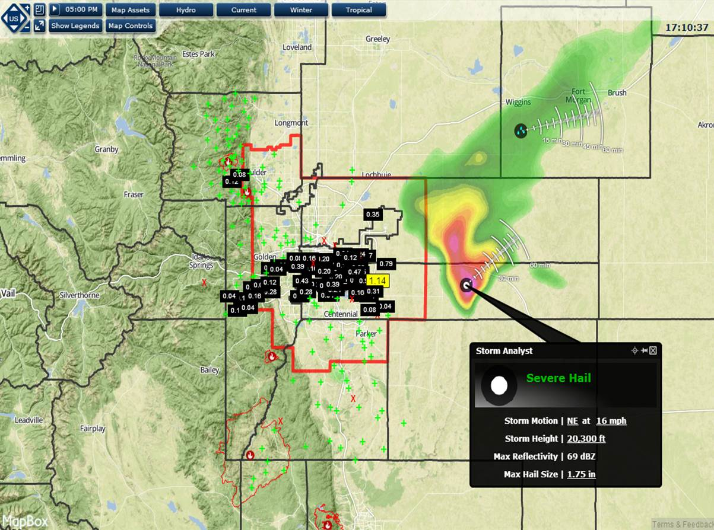
Radar Options
SECTION 3

Slide 44
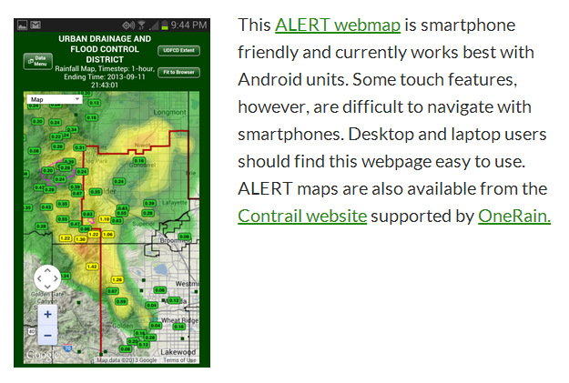
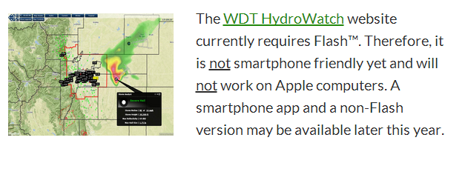
Both of these maps are good choices for viewing current radar. They are found from the Maps menu. ALERT rainfall totals are shown on both maps by default.

Slide 45


ALERT Map
This is the most popular map for viewing both real-time and archived ALERT data. The current radar loop and NWS warning boxes are on by default. Users can control these and other settings from the Data Menu (top-left). The ALERT rainfall amounts displayed are totals for the previous hour. Other time periods can be selected from the Data Menu. Click on the stations to see time-series plots and tabular summaries. Links to access more information are provided in the pop-up boxes. The map background can also be change to other common Google Maps (top-left).

Slide 46
WDT iMap-Pro HydroWatch
This is UDFCD’s custom radar website. The ALERT rainfall amounts displayed are totals for the previous 6-hours. Click on values and other map features for more information. Use the menu items at the top for selecting options. Hydro features (QPE & QPF) are especially useful when storms are affecting UDFCD (see next page). The play button next to the data display time (top-left) will initiate the looping feature. The time displayed top-right is the current commuter clock time. Spend time to become familiar with the many options available here.

Slide 47




HydroWatch Hydro Menu
Selecting this menu will produce the above pop-up indicating that Rain Gauges are ‘ON’ by default. The subsequent menu choices enable selecting radar-derived gage-corrected rainfall estimates and forecasts (QPE & QPF) for various time periods. Displaying too many radar data overlays simultaneously will clutter this map display quickly.

Slide 48

HydroWatch QPE Grid Example
Rain gauges are turned off in this example via the [Hydro] menu. Also, the [Current] menu was used to disable the National Mosaic Radar. Concurrent overlaid Radar images will distort the colors.
Event Date: July 7, 2014

Slide 49

HydroWatch QPE Basin Avg. Example
QPF (Quantitative Precipitation Forecast) map products will look similar to this. Use the [Map Controls] menu to change the background. Use [Map Assets] menu to add the floodplains layer.
Event Date: July 7, 2014

Slide 50




HydroWatch Current Menu
Selecting this menu shows that the National Mosaic Radar display is ‘ON’ by default. The subsequent menu choices are shown at the right. Selections can be toggled ON/OFF as desired. The blue dotted line points to a storm attribute for heavy rainfall in this example. Storm Attributes are ‘ON’ by default. Familiarize yourself with these options.

Slide 51

HydroWatch Other Controls
Pan & Zoom
Many mapping control options are available. Familiarize yourself with these.

Slide 52


Other Radar Options
Menu selection icon for smartphone users.
Many radar websites and apps are available. Users of RainVieux, PreVieux and Vflo™ (see HYDROMODELS menu) have access to other UDFCD-supported custom radar products.

Slide 53

Real-Time Hydro Models
SECTION 4

Slide 54

HYDROMODELS
INFORMATION ONLY
Not currently available in Aurora. The LRE models can be viewed but the Vieux products require a user name and password to access.

Slide 55

UDFCD Email Subscription Lists
SECTION 5
F2P2 Products, ALERT System Alarms & EMWIN-Denver Regional
400 Montview Park Precipitation-AD 5.00 inches in 6hours alarm at 09/12/2013 10:49:17

Slide 56

Email Subscriptions
Use SUBSCRIBE menu to sign-up for short text and long versions of the HPO/IMS, Aurora Messages, ALERT rainfall alarms, NWS warnings and other desired products.

Slide 57

http://lists.udfcd.org
The Notifications link on the SUBCRIBE menu will take you to this webpage.

Slide 58

F2P2 Forecast Products
Top selection from previous slide.

Slide 59

Daily Message Potentials
These subscriptions will deliver an abbreviated jurisdiction-specific version of the daily Heavy Precipitation Outlook (HPO). If text messaging is also desired, just send an email request to Kevin Stewart at UDFCD following the instructions on the previous slide. An SMS version of the IMS-Internal Message Status will also be sent with the word “ISSUED” appended to the subject line.

Slide 60

F2P2 Flood Threat Messages
These are the most important messages to receive. Both long and short message formats are recommended.

Slide 61


ALERT Rainfall Alarms
Automatic notification from UDFCD’s ALERT system whenever a predefined rainfall rate threshold is exceeded.
0.5” in 10-min or less
1” in 1-hour or less
3” in 2-hours or less
5” in 24-hours or less
10” in 72-hours or less

Slide 62

NWS Warnings via EMWIN-Denver
These subscription lists provide a convenient way to automatically receive products from the NWS Emergency Managers Weather Information Network (EMWIN). Both long and short formats are available. Follow the same instructions provided on the previous slides. The 5 circled counties would all be appropriate for Aurora. The downside of subscribing to all 5 will be receiving multiple emails of the same product when the warning or advisory includes more than one county.

Slide 63
Preparing for the 2014 Storm Season
Go to the UDFCD websites and practice surfing for information
  Review info from yesterday’s storm
Identify a weather webpage
  Learn to use radar pages
  Look at the forecast info

Slide 64
2014 Expectations
Monitor information
  Plan to respond when a Message 2 or 3 is issued
Respond if necessary to a Message 1 Low Impact Flooding
  1” or more in 30 minutes
  2” or more in 1 hour
Safety is critical
Provide updates to SW supervisors & superintendent
Call for assistance
Photo or video observed flooding impacts

